Slide 1
Python For Everyone
Avnit Bambah

Slide 2
Avnit Bambah
20 years of IT experience
Developer, Manager, Security Architect
BE and MS Computer Science and MBA in Finance, Loyola University
Love coding projects, building servers and IoT projects.

Slide 3
Installing Python
Download
https://www.python.org/downloads/
Development environment
Visual studio code https://code.visualstudio.com/download
PyCharm Community Edition https://www.jetbrains.com/pycharm/

Slide 4
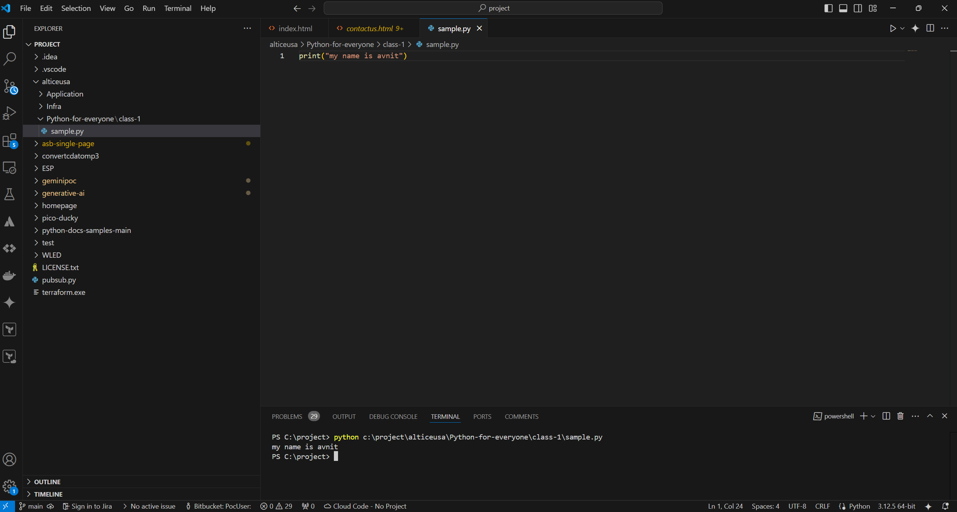
Running the first program

Slide 5
Create a GitHub account
Sharing the code
Share the github account with me before the next session
fork my repo https://github.com/avnit/Python-for-everyone
Open the folder Class -1
These slides are in that folder

Slide 6
Git hub Account
1. Creating a GitHub Account
Go to GitHub: Open your web browser and navigate to https://github.com/
Sign Up: Click the "Sign up" button.
Enter Information:
Provide your email address.
Create a strong password (at least 15 characters or 8 with a mix of letters and numbers).
Choose a username for your GitHub profile.
Verify Email: Check your email inbox for a verification code from GitHub. Enter this code on the GitHub page.
Personalize (Optional): GitHub may ask you some questions to personalize your experience. You can skip this step.
Choose a Plan: Select the "Free" plan to start.

Slide 7
Git Hub Account
2. Accessing Code on GitHub
Find the Repository: Go to the specific repository URL (in this case, https://github.com/avnit/Python-for-everyone).
View Code:
Browse Files: You can directly view the code files within the repository by clicking on them.
Download ZIP: Download the entire repository as a ZIP file by clicking the green "Code" button and then "Download ZIP."
Clone the Repository:
If you're familiar with Git, you can clone the repository to your local machine using the provided URL. This allows you to work with the code directly on your computer and contribute changes back to the repository.

Slide 8
Git Hub Basics
Public vs. Private Repositories:
Public repositories are visible to everyone on GitHub.
Private repositories require a GitHub account to access and are only visible to you and collaborators you invite.
Forking a Repository:
If you want to make changes to the code without affecting the original repository, you can "fork" it. This creates a copy of the repository under your own GitHub account.
For cloning the repo use the following command
Git clone https://github.com/avnit/Python-for-everyone.git
Optional : use extensions – github pull and python

Slide 9
Python basics
Variable and Data Types
Numerical Data Types
Data Type | Keyword | Description
Integer | Int | A whole number
Float | Float | A floating point number
Complex | Complex | A complex Number (which has a real and a imaginary part to it)

Slide 10
Strings
Strings are basic sequence of characters or basically a text.
Strings are always surrounded by quotation marks
Keyword is str
Example
a = “my name is xyz”
Type function helps us determine what is the type of the variable it is.

Slide 11
Concat two strings
a = “my name”
b = “xyz”
c = a + b
Print(c)

Slide 12
Booleans
It can be True or False
Keyword bool

Slide 13
SEQUENCES
Collection of variable, objects
Data Type | Keyword | Description
List | List | Collection of values
Tuple | Tuple | Immutable list
Dictionary | Dict | List of key value pairs

Slide 14
Operators
Operator | Name | Description | Example
+ | Addition | Adds two numbers | 5+2 = 7
- | Subtraction | Subtracts two numbers | 5-2=3
* | Multiplication | Multiples two numbers | 5*2 =10
/ | Division | Divides two numbers | 5/2 =2.5
% | Modulus | Returns the remainder of a division | 5%2 =1
** | Exponent | Takes a value to the power of another value | 5**2 = 25
// | Floor division | Returns the result of a division without decimal places | 5//2 =2

Slide 15
Assignment Operators
Operator | Description | Example
= | Assigns a value to variable | A = 10
+= | Adds a value to a variable | A += 1
-= | Subtracts a value from the variables | A -= 1
*= | Multiplies a values with a variable | A *= 10
/= | Divides the variable by a value | A /= 10
%= | Assigns the remainder of a division | A %= 2
**= | Assigns the result of a exponential | A**=2
//= | Assigns the result of a floor division | A //= 2

Slide 16
Comparison Operators
Operator | Name | Description | Example
== | Equals | Two values are the same | a == b 10 == 10 -> True
!= | Not Equals | Two values are not the same | a != b 10 != 20 -> True
> | Greater than | One value is greater than the other | a > b
< | Less than | One value is less than the other | a < b
>= | Greater than or equal | One value is greater than or equal to another | a >= b
<= | Less than or equal to | One value is less than the other value | a <= b

Slide 17
Logical Operator
Operator | Description
Or | At least one has to be true
And | Both has to be true
Not | Negates the input
A is true and B is false
A or B is true
OR (A/B) | True | False
True | True | True
False | True | False

Slide 18
AND operator
AND (A / B ) | TRUE | FALSE
TRUE | TRUE | FALSE
FLASE | FALSE | FALSE

Slide 19
USER INPUT
Name = input(“please enter your name”)
Print (name)

